Slide 1
Chapter 6
The Cloud
Notes:
Until about 2010, most organizations constructed and maintained their own computing infrastructure. Organizations purchased or leased hardware, installed it on their premises, and used it to support organizational email, Web sites, e-commerce sites, and in-house applications, such as accounting and operations systems. After 2010, however, organizations began to move their computing infrastructure to the cloud. In the future, nearly all, computing infrastructure will be leased from the cloud.

Slide 2
“How About $10 Per Terabyte.”
Lease storage capacity from third party
All incoming data from drones automatically uploaded
Average monthly storage costs cut at least 50%
Power savings, backup time saved, no new hardware configuration
One-time set up and development costs
Notes:
Use scenario to:
Illustrate importance (and promise) of the cloud.
See firsthand the benefits of the cloud to business.
Set up a skeptical view of cloud benefits and use that skepticism to motivate the learning of this chapter’s contents.

Slide 3
Study Questions
Q1: Why is the cloud the future for most organizations?
Q2: How do organizations use the cloud?
Q3: How can Falcon Security use the cloud?
Q4: How can organizations use cloud services securely?
Q5: What does the cloud mean for your future
How does the knowledge in this chapter help you?
Notes:
Business people need the knowledge in this chapter to answer questions like these. In the 21st century, many of your competitors will be able to answer these questions without hiring outside consultants.

Slide 4
Q1: Why Is the Cloud the Future for Most Organizations?
The Cloud
Elastic leasing of pooled computer resources via Internet
Elastic
Automatically adjusts for unpredictable demand
Limits financial risks
Pooled
Same physical hardware
Economies of scale
Notes:
Organizations are moving their computing infrastructure to the cloud. Leasing computing infrastructure from the cloud will become common practice.

Slide 5
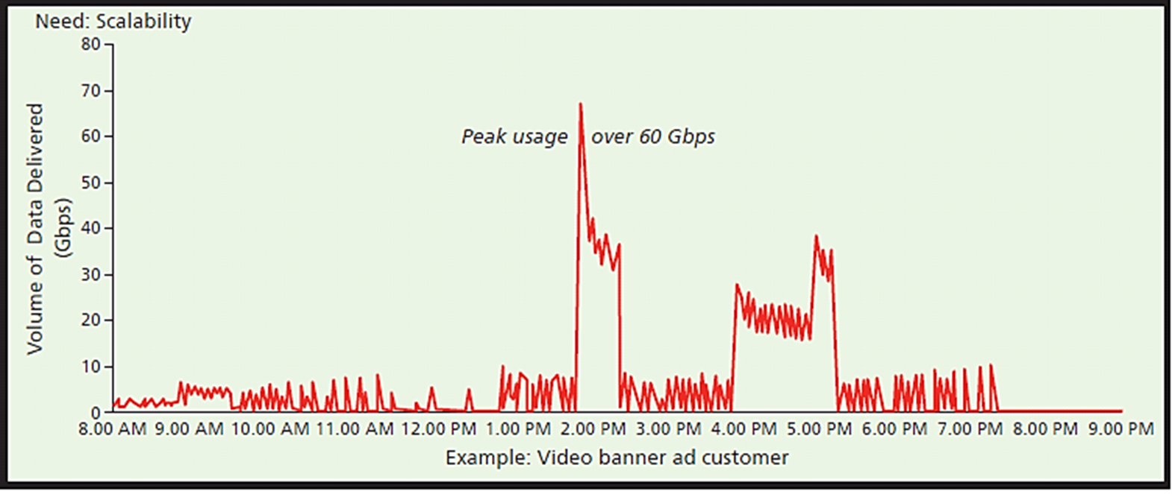
Example of a Video Banner Ad Customer
Notes:
Figure based on real case supported by Amazon.com’s CloudFront
Without increase in servers, response times of 3 or 5 seconds are far too long to maintain attention of a viewer.

Slide 6
Pooled
Pooled resources
Same physical hardware
Virtualization
Economies of scale
Average cost decreases as size of operation increases
Major cloud vendors operate enormous Web farms
Over the Internet
Service-oriented architecture (SOA)
Web service standards
Notes:
Both cloud vendors and electrical utilities benefit from economies of scale. According to this principle, the average cost of production decreases as the size of the operation increases.
Using SOA, programs formally define the services they perform, the data they expect, and the results they produce.
These standards enable computers that have never “met” before to organize a dizzying, worldwide dance to deliver and process content to users.

Slide 7
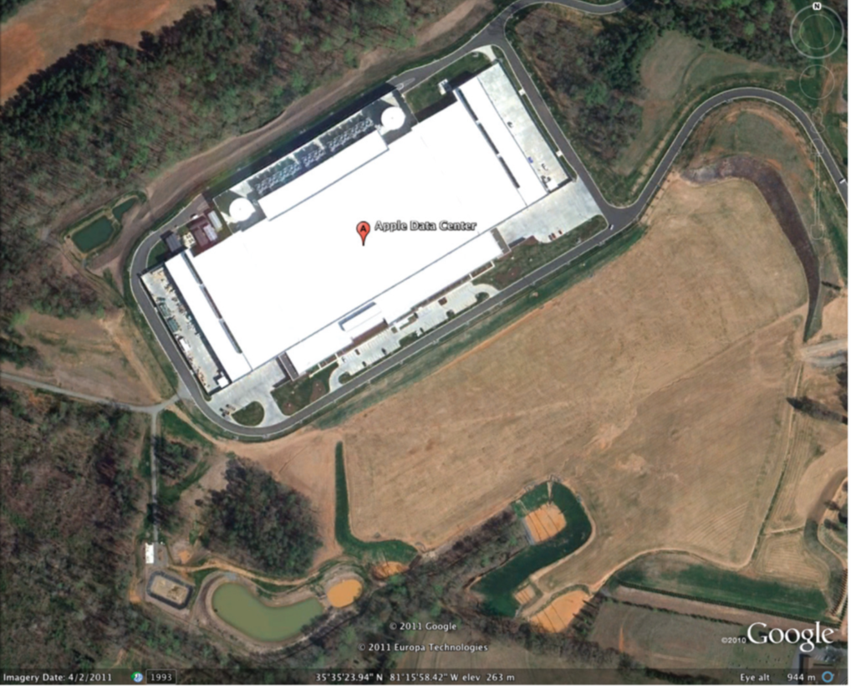
Apple Web farm in Maiden, NC $1B+ facility contains more than 500,000 sq. ft.
Notes:
Constructed in 2011 to support its iCloud.
Amazon.com, IBM, Google, Microsoft, Oracle, and other large companies operate several similar farms worldwide.

Slide 8
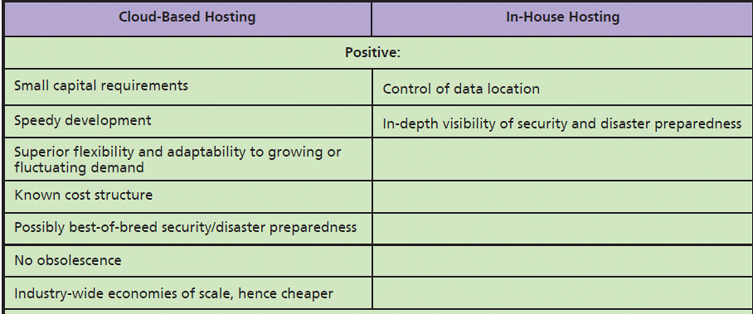
Why Is the Cloud Preferred to In-House Hosting?
Notes:
Comparison of cloud and in-house alternatives.

Slide 9

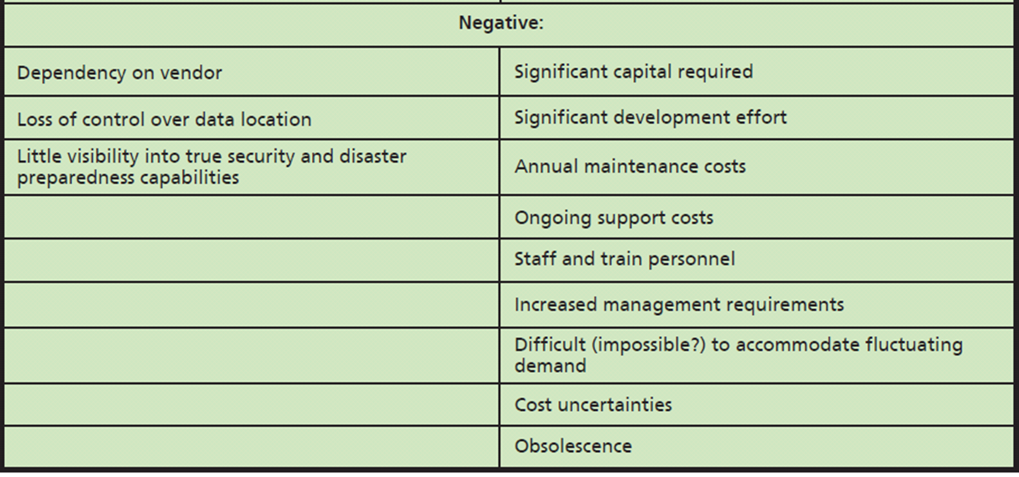
Why Is the Cloud Preferred to In-House Hosting? (cont'd)
Notes:
Continuation of Figure 6-3.

Slide 10
Why Now?
Cheap processors, essentially free data communication and data storage
Virtualization technology
Internet-based standards enable flexible, standardized processing capabilities
Notes:
Cloud-based hosting has been around since the 1960s. Long before the creation of the personal computer and networks, time-sharing vendors provided slices of computer time on a use-fee basis. However, the technology of that time, continuing up until the first decade of this century, did not favor the construction and use of enormous data centers, nor did the necessary standards exist.

Slide 11
When Does the Cloud Not Make Sense?
When law or standard industry practice require physical control or possession of the data
Ex: Financial institution legally required to maintain physical control over its data

Slide 12
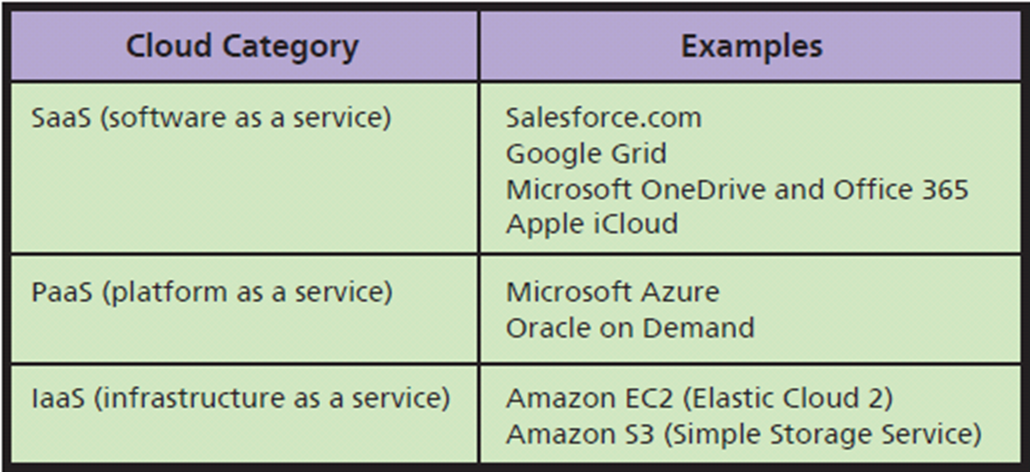
Q2: How Do Organizations Use the Cloud?
Three Fundamental Cloud Types
Cloud Services from Cloud Vendors
Notes:
Organizations can use the cloud in several different ways. By far most popular, is to obtain cloud services from cloud service vendors.

Slide 13
Content Delivery Networks from Cloud Vendors
Content delivery network (CDN)
System of distributed servers that deliver webpages and other Web content
Specialized type of PaaS, own category
Minimizes latency
Stores and delivers based on geographic locations of users
Notes:
System of distributed servers (network) that deliver webpages and other Web content to a user based on the geographic locations of the user, the origin of the webpage and a content delivery server.

Slide 14
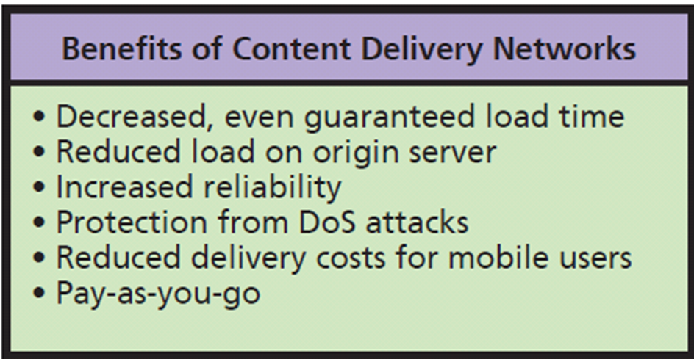
CDN Benefits
Notes:
You will learn about denial-of-service (DoS) attacks in Chapter 10. For now, just understand that such security threats send so much data to a given server that the server’s performance for legitimate traffic becomes unacceptable. By having multiple servers, CDNs help to protect against such attacks.

Slide 15
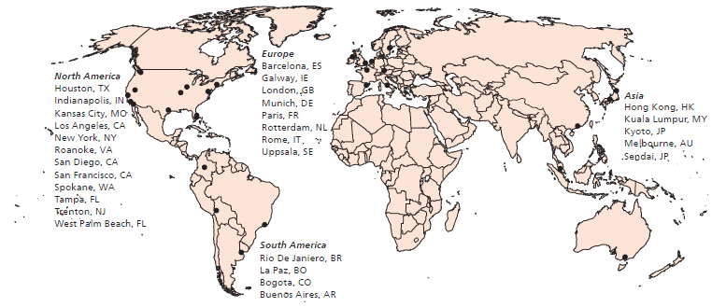
Servers Used in a Typical CDN Service
CDN maps
Notes:
Figure 6-6 shows an example of how CDN servers might be distributed.
Falcon might use a CDN to distribute its content worldwide and to respond to leads generated from advertising as described in Q1.
Other CDN maps here. https://www.google.com/search?q=content+delivery+network+map&safe=active&espv=2&biw=1093&bih=514&tbm=isch&tbo=u&source=univ&sa=X&ved=0CDEQsARqFQoTCJ7ShsKdi8gCFUJcPgodpmcA4Q

Slide 16
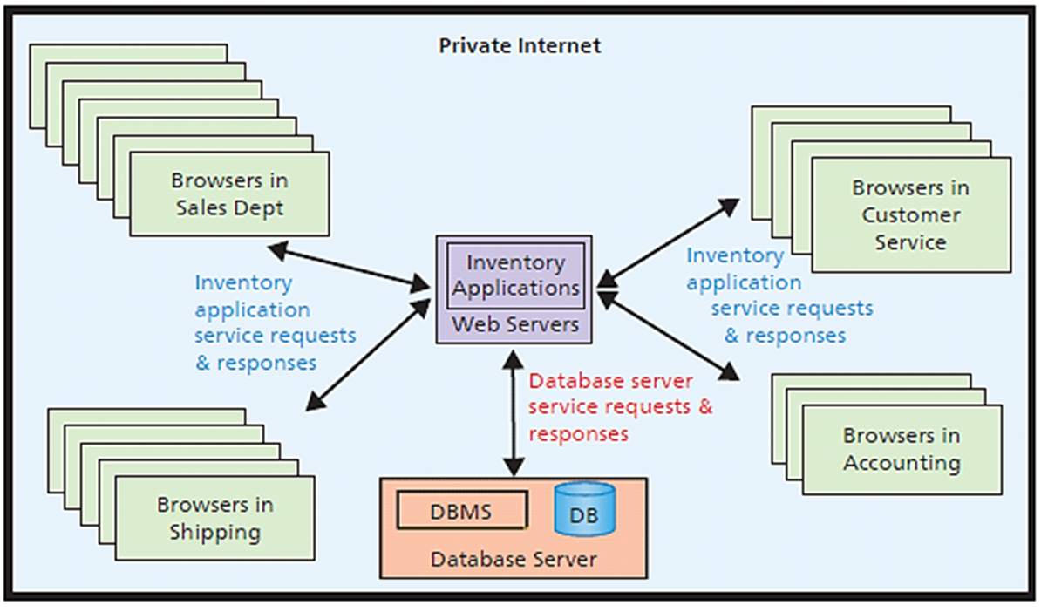
Using Web Services Internally
Web Services Principles
Applied to Inventory
Applications
Notes:
This figure shows a Web services inventory application at a hypothetical online bicycle part retailer named Best Bikes.
In this example, Best Bikes is running its own servers on its own infrastructure. To do so, Best Bikes sets up a private internet within the company, an internet that is generally not reachable from outside the company.
Best Bikes writes the applications for processing inventory using Web services standards; applications publish a WSDL; the Web services are accessed by other applications within the company using SOAP; and data are delivered using JSON.
Application users access the inventory Web services using JavaScript that is sent down to the users' browsers.

Slide 17
Q3: How Can Falcon Security Use the Cloud?
Some SaaS products Falcon Security could use
Google Mail
Google Drive
Office 365
Salesforce.com
Microsoft CRM OnLine
many others . . .
Notes:
Falcon Security Parts is a small company with a very small IT Department, and unlikely to have resources necessary to develop its own server infrastructure.

Slide 18
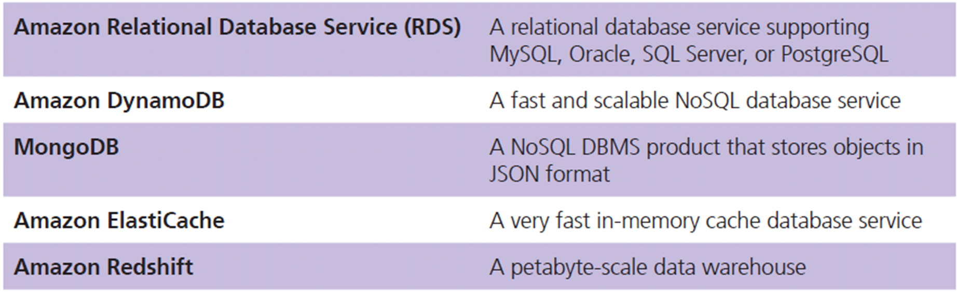
PaaS Services from Amazon DBMS Products with Elastic Cloud 2 (EC2)
Falcon Security could use CDN to distribute content worldwide and respond to leads generated from advertising
Notes:
Falcon Security lease hardware and operating systems from cloud vendor.
It could install its own, in-house developed applications, or it could install other applications licensed from a software vendor.

Slide 19
IaaS Services at Falcon Security
Provides basic hardware in the cloud
May acquire servers to load operating systems
Considerable technical expertise and management
Alternative: use elastic data storage services
SaaS and PaaS provide more added value to Falcon Security

Slide 20
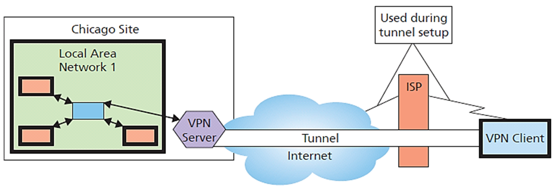
Q4: How Can Organizations Use Cloud Services Securely?
Remote Access Using VPN: Actual Connections
Notes:
Internet is a jungle of threats to data and computing infrastructure, as discussed in Chapter 10.
How can organizations realize the benefits of cloud technology without succumbing to those threats?
VPN technology uses public Internet to create appearance of a private connection on secure network.
Virtual means something that appears to exist but, in fact, does not.
Expect that cloud security will evolve beyond that described here throughout your career. We begin with a discussion of VPNs, a technology used to provide secure communication over the Internet.

Slide 21
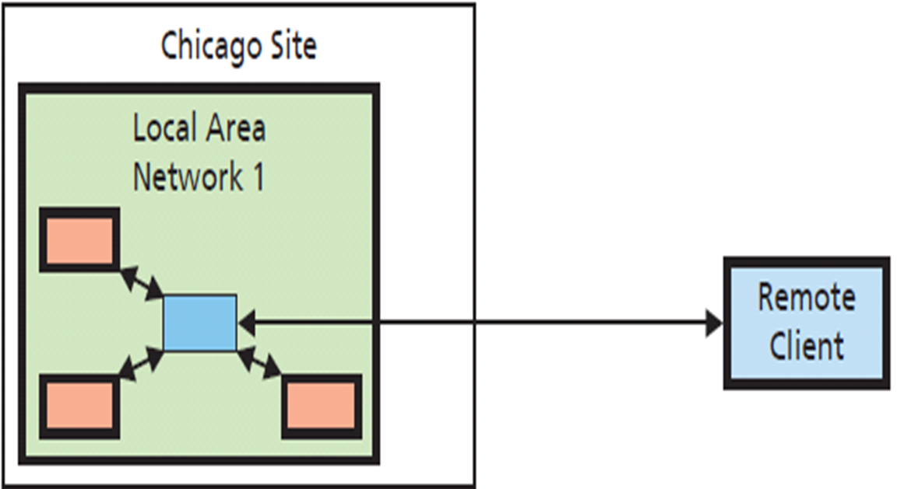
Remote Access Using VPN: Apparent Connection
Notes:
Figure 6-9 illustrates the connection as it appears to the remote user.
VPN client software encrypts messages so their contents are protected from snooping.
Then, the VPN client appends the Internet address of the VPN server to the message and sends that package over the Internet to the VPN server.
When the VPN server receives the message, it strips its address off the front of the message, decrypts the coded message, and sends the plain text message to the original address inside the LAN.

Slide 22
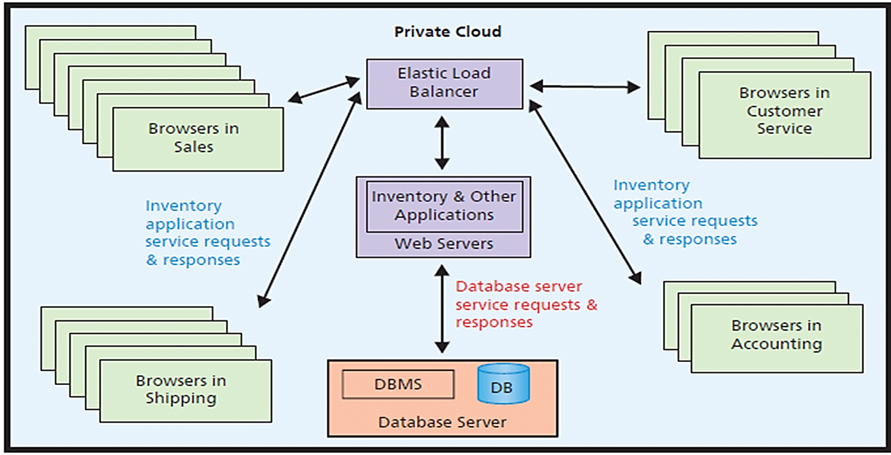
Private Cloud for Inventory and Other Applications
Notes:
To create a private cloud, the organization creates a private internet and designs applications using Web services standards just as shown in Figure 6-10.
In a server farm, the servers are managed by elastic load balancer devices.
Most organizations do not replicate database servers.

Slide 23
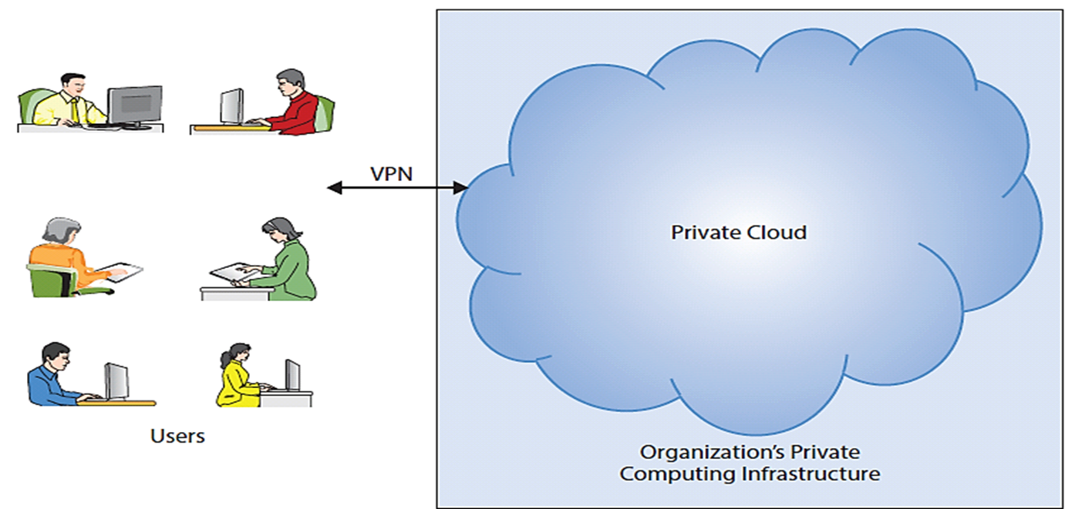
Accessing Private Cloud over a Virtual Private Network
Notes:
Private clouds provide security within the organizational infrastructure but do not provide secure access from outside that infrastructure.
To provide such access, organizations set up a VPN and users employ it to securely access the private cloud.
Private clouds provide the advantages of elasticity, but to questionable benefit. What can organizations do with their idle servers?

Slide 24
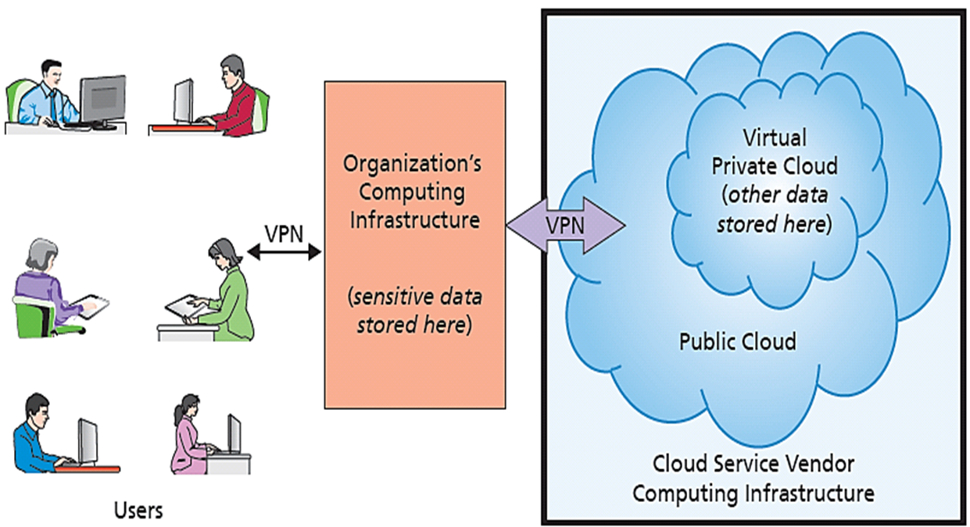
Using A Virtual Private Cloud
Using a Virtual
Private Cloud (VPC)
Notes:
Organization can store most sensitive data on own infrastructure, and store less sensitive data on VPC. Thus, organizations required to have physical control over some of their data can place it on own servers and locate rest on VPC.
Falcon Security could reduce its storage costs by 50 percent, if it moves its data to the cloud.

Slide 25
Q5: What Does the Cloud Mean for Your Future?
Cloud services faster, more secure, easier to use, cheaper
Fewer organizations set up own computing infrastructure
More pooling of servers across organizations
Overall size of the cloud gets bigger
Individuals, small businesses, large organizations obtain elastic resources at very low cost
Cloud fosters new categories of work
Notes:
Absent some unknown factor such as a federal tax on Internet traffic.
Individuals on iCloud or Google Grid, to small groups using Office 365, to Small companies like Falcon Security Parts using PaaS, to huge organizations using IaaS.

Slide 26
Remote Action Systems
Telediagnosis
Telesurgery
Telelaw enforcement
Provide services in dangerous locations
Watch top-notch performers and performances
Reduces value of local mediocrity?
Notes:
By enabling action at a distance, remote action systems save time and travel expense and make the skills and abilities of an expert available in places where he or she is not physically located. They also enable experts to scale their expertise.

Slide 27
So What? "Net Neutrality Enabled"
ISPs little control over amount, type, or origin of content
30% of U.S. Internet traffic during peak hours associated with people using Netflix
Net neutrality
All users and content providers treated equally
No “fast” or “slow” lanes
ISPs not allowed to block or slow content associated with competitors
ISPs can’t charge heavy Internet users additional fees or taxes
Notes:
Today’s digital resources are up for grabs. Companies are trying to stake claim to intellectual property, data streams, and bandwidth.

Slide 28
FCC Approved New Regulations (2015)
Renders Internet a utility
Complaint: Interfering with free markets
ISPs loss of potential revenue stream will inhibit infrastructure development, limit growth, and stifle new innovation
Is that true?
Larger war on net neutrality may have only begun!
Notes:
Federal Communications Commission (FCC) recently made an important ruling on net neutrality and became the new sheriff in town.

Slide 29
Ethics Guide: Cloudy Profit?
Data broker (a.k.a., data aggregator)
Specialize in acquiring and analyzing market, buyer, and seller data for real estate agents
Alliance transitioned data storage and processing from own Web farm to the cloud
Improved speed and quality of data services at fraction of prior costs, cut in-house hardware support staff by 65%
Plowing money back into R&D
Notes:
Goals
Alert students to:
Incredible profits can result from using the cloud.
Extreme profits for successful businesses.
Ethical issues of success and ethical considerations of wealthy.
What goes up can come down; level of profitability is probably not sustainable.
Discuss why cloud is a game changer (cheap communications, cheap servers, virtualization, sharing of hardware, Web standards).

Slide 30
Security Guide: From Anthem to Anathema
Greater accessibility => more accessible to hackers
80 million customers affected
Stole names, addresses, Social Security numbers, and salaries
Stored in plain text format
Lawsuits filed
Premera Blue Cross
Bank-account and medical data of 11 million customers
Notes:
Goals
Alert students to:
An example of a large-scale data breach of a cloud-based service provider.
Security issues related to cloud-based services.
The trade-offs associated with implementing cloud-based services.
Security practices could evolve from being a necessary evil to becoming a competitive advantage.

Slide 31
How Does the Knowledge in This Chapter Help You?
Cloud knowledge key for all business professionals in early years of career
Anticipate new categories of jobs you might find rewarding
Save your organization considerable money

Slide 32
Active Review
Q1: Why is the cloud the future for most organizations?
Q2: How do organizations use the cloud?
Q3: How can Falcon Security use the cloud?
Q4: How can organizations use cloud services securely?
Q5: What does the cloud mean for your future?
How does the knowledge in this chapter help you?

Slide 33
Case Study 6: Cloud Solutions that Test for Consumer Risk and Financial Stability
Europe’s financial center - London Stock Exchange: ‘Big Bang’ and deregulation of financial services (1986)
Majority of manual processes of financial services moved to computer-based information systems trading (1997)
Huge advances in computing power: sophisticated financial algorithms, new products, light-touch regulation (2000)
Speed of innovation in highly technical financial services incompatible with light-touch regulatory framework (2013)
Notes:
Explain how technology advancement affects legal requirements for preservation of financial data.

Slide 34
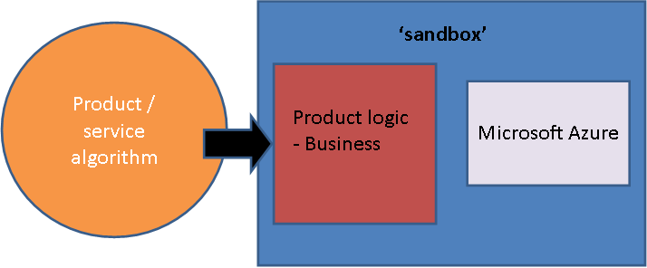
Components of the ‘sandbox’ Cloud System
Notes:
This is the fundamental structure of the FinQloud system.
Amazon S3 provides scalable, elastic storage.
FinQloud processes the data in such a way that it cannot be updated, encrypts the data, and transmits the processed, encrypted data to AWS, where it is encrypted yet again and stored on S3 devices.
Data is indexed on S3 and can be readily read by authorized users.

Slide 35
Cloud Solutions … ‘sandbox’ (cont'd)
Financial regulators including the FCA (United Kingdom), the MAS (Singapore) and FSA / FISC (Japan) looking at technology trends appropriate to regulating innovative financial products
The FCA in the United Kingdom develops an indicative Cloud based Sandbox toolkit (2015)
The Sandbox solution tests new financial products before they enter the consumer market place – a ‘safe space’
Reduces consumer risk and promotes financial stability

